Slide 1



Multi-Class Animal Recognition for Wildlife Conservation

Slide 2

Multi-Class Animal Recognition for Wildlife Conservation
This presentation explores how image recognition can protect endangered species. It also describes real-time monitoring to prevent poaching. Understanding ecosystem dynamics is also key.
RV

Slide 3
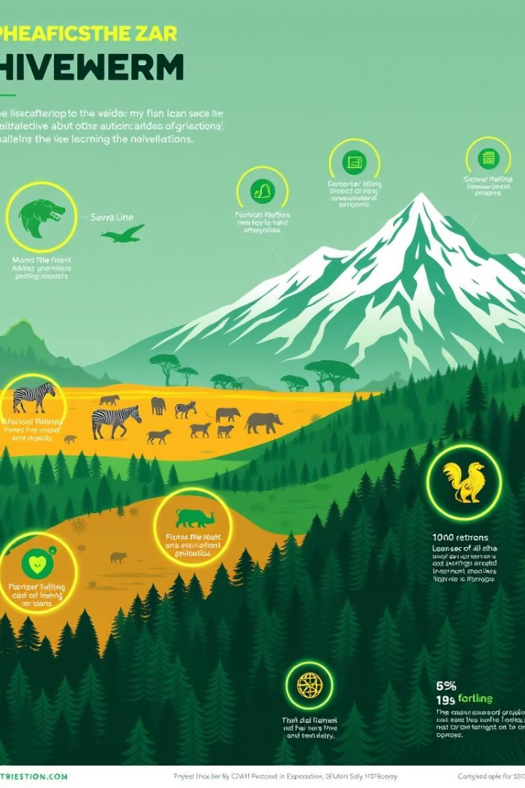
Learning Objectives
1
Understand the need
Explore the importance of multi-class animal recognition in conservation.
2
Identify tools
Identify tools and technologies employed in recognition systems.
3
Learn the methodology
Learn the methodology involved in building such systems for wildlife.
4
Appreciate real-world impact
Appreciate real-world applications and impact on conservation efforts globally.

Slide 4
The Challenge: Wildlife Conservation
Habitat loss and poaching are major threats. Traditional methods are often labor-intensive. We need automated, scalable monitoring.
Traditional Methods
AI Solutions
Labor-intensive
Automated analysis
Slow and reactive
Real-time insights
Difficult to scale
Scalable monitoring

Slide 5
Problem Statement: Wildlife Conservation Challenges
Manual methods are Limited
Automated system needed
Need for automated, accurate, and scalable species identification.
Current methods include manual tracking, camera traps, and aerial surveys.
Addresses habitat loss and poaching
Labor-intensive and costly
Mitigates impact of climate change.
Limited coverage and species misidentification.

Slide 6





Tools and Technologies Used
Python
AWS, Azure
Camera Datasets
YOLOv5
Programming language for scripting and model development.
Object detection models for species identification.
Cloud computing platforms for scalable deployment.
Snapshot Serengeti and LILA BC datasets.

Slide 7








Real-World Applications
Habitat Monitoring
Biodiversity
Anti-Poaching
Assess species distribution and abundance accurately.
Identify and classify species in diverse ecosystems.
Detect and track endangered species in real-time environments.
Conflict
Monitor animal movement and behavior effectively.

Slide 8

Conclusion
Powerful Tool
Efficiency
Multi-class animal recognition is a powerful tool for conservation.
Enhances efficiency, accuracy, and scalability of conservation efforts.
Crucial Research
Ongoing research and development are crucial for advancement.

